Slide 1

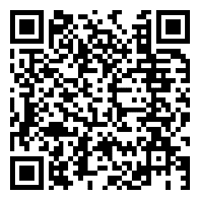
Customer Cases
Scan this QR code to watch DOBOT customer cases on YouTube.

Slide 2
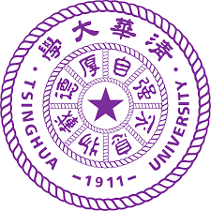


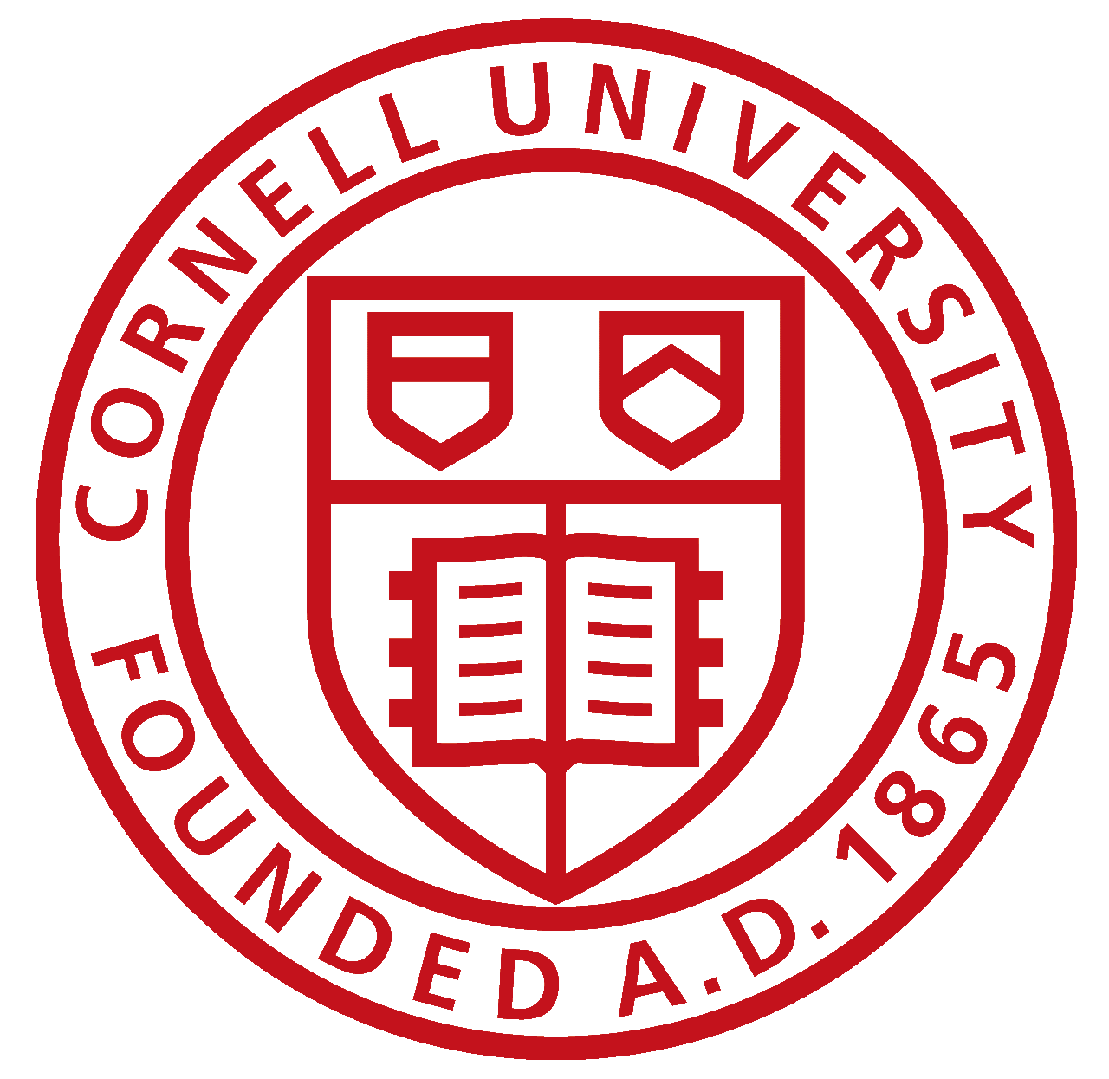
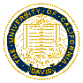







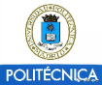
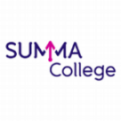








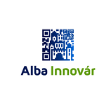





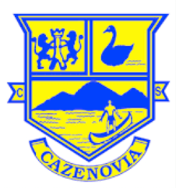






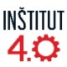

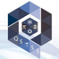








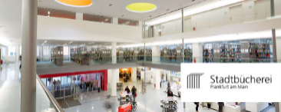
covering 3000+ schools and enterprises
36

Slide 3
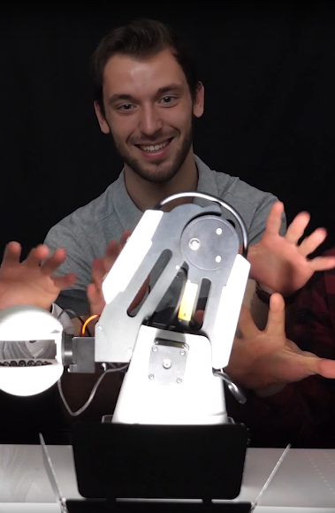
Higher Education

Slide 4

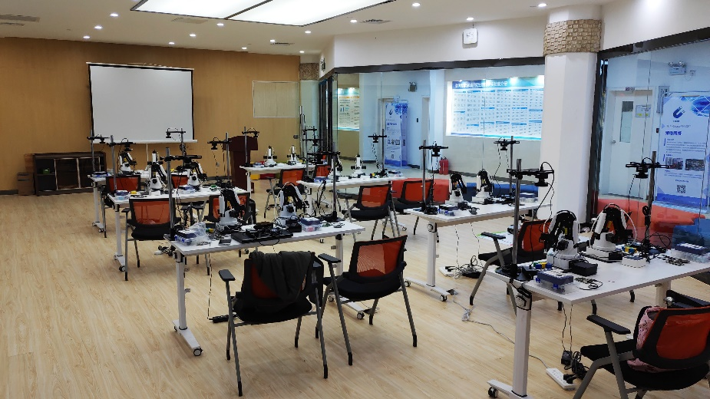
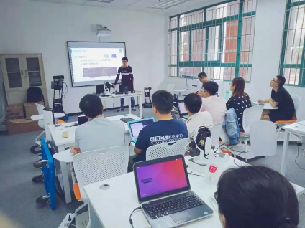
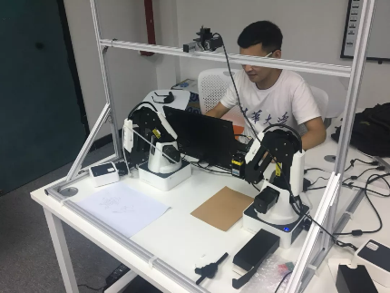
Tsinghua University
China
Tsinghua University partners with DOBOT to launch the Control Engineering Lab. At this lab, DOBOT Magician robots serve as the main platform for operation. The robot is equipped with a camera, a stand and other assistive devices.
This system enables students to develop further using their desired programming language. Students not only can learn and understand how robotic vision and robotics work, but also have opportunities to have hands-on experience and practice what they have learned. Besides, students can take their study and development further by diving into subjects such as multi-robot collaboration, working space interference, and robot vision applications.
38

Slide 5
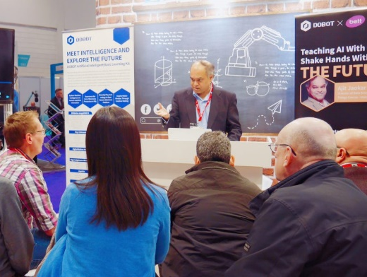
University of Oxford
United Kingdom
Professor Ajit Jaokar and his team from the University of Oxford incorporate DOBOT Magician into the new course of Data Science for the Internet of Things.
The course aims to develop a new kind of talents that are capable of combining IoT and AI to solve real world problems human kind are facing. Professor Ajit also set up an AI lab in London, where his team explores specific robotics & AI deep learning technologies using robotic arms.
For this course, students have opportunities to use DOBOT Magician and explore robotics and deep learning including Neuro-Linguistic Programming (NLP), Convolutional Neural Network (CNN) and Reinforcement Learning(RL).
Professor Ajit is giving a speech at DOBOT booth #F320, BETT 2018
39

Slide 6

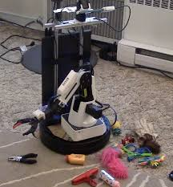
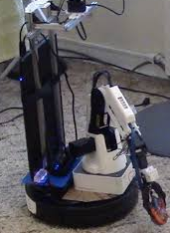
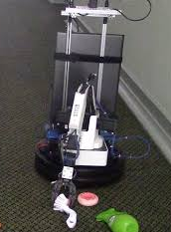
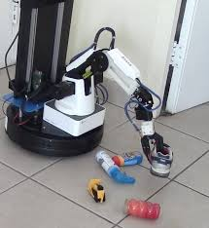
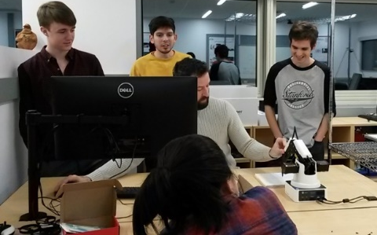
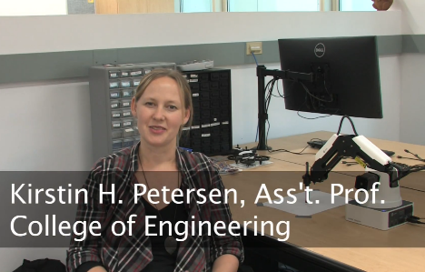
Carnegie Mellon University
United States
Four students from the Robotics Institute, Carnegie Mellon University use DOBOT Magician robots in home settings to improve generalization and reduce dataset bias. First, they assemble the with a mobile base, a camera, a gripper and stabilizers. Then, they use the transformed robot to collect data inside 6 different homes for training and 3 homes for testing. They present an architectural framework which factors out the noise in the data. The study demonstrates it is crucial to train models with data collected in households if the goal is to eventually test them in homes.
Cornell University
United States
Cornell University has incorporated sets of DOBOT Magicians into their Collective Embodied Intelligence Lab. Their research involves design and coordination of large robot collectives able to achieve complex behaviors beyond the reach of single robot systems, and corresponding studies on how social insects do so in nature.
Major research topics include swarm intelligence, embodied intelligence, autonomous construction, bio-cyber physical systems, human-swarm interaction, and soft robots.
40

Slide 7
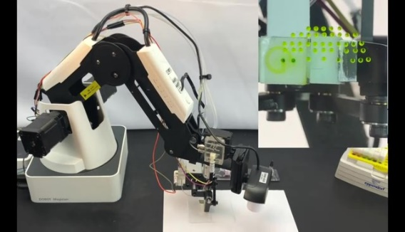
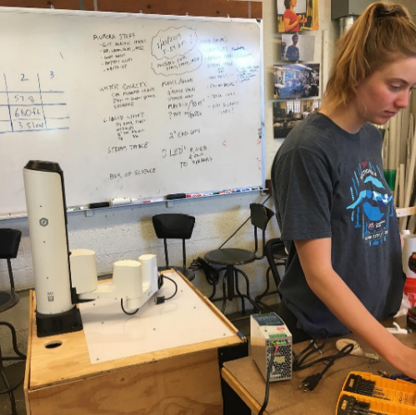
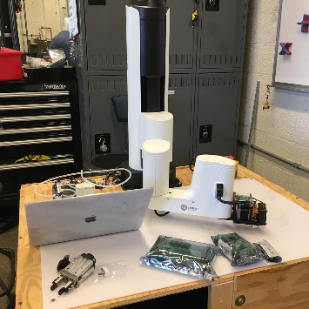
University of California, Davis
United States
A group of students from UC Davis turn DOBOT Magician into a liquid handling robot to explore how researchers in the medical lab can use robots to improve the efficiency of handling minute volumes of medical samples.
They install a grabber on the robot to grab the liquid container and the pneumatic drive to power the microfluidic cap through the contact interface. They also use an I/O expansion coordinate and synchronize movement, catch-and-release and dispensing, and machine vision to identify and locate the container with the targeted reagent using the QR code.
Massachusetts Institute of Technology (MIT)
United States
Engineering students from Massachusetts Institute of Technology use DOBOT M1 to develop creative projects and display them to the audience at MIT xFair 2019, MIT's largest career fair & tech expo.
41

Slide 8
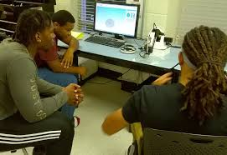
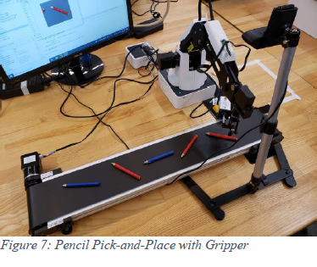
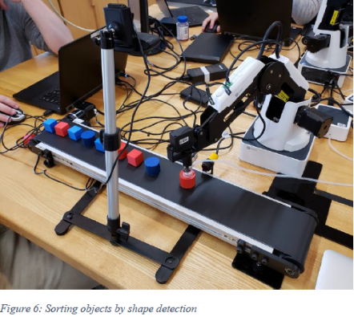
University of West Florida
United States
Dr. S. M. Mizanoor Rahman from University of West Florida uses DOBOT Magician to compare two different methods of teaching mechanical engineering concepts. He conducts two independent studies, one with demonstrations using DOBOT Magician and the other in traditional classroom settings.
The result is that robot-based teaching and learning produces better outcomes than ordinary teaching. The interactions between the students and the robot were also found satisfactory.
Pennsylvania State University
United States
Professor Robert L. Avanzato from Pennsylvania State University uses DOBOT Magician to evaluate how effective a MATLAB interface to ROS services controls an articulated robot manipulator and conveyor belt in a laboratory setting.
This project describes the development of a MATLAB/ROS interface and educational resources for a low-cost robot arm (Dobot Magician) in a senior-level robotics course. Topics cover the basic interfacing MATLAB and ROS services, pick and place operations, control of a conveyor belt and IR sensor, and computer vision for color sorting and shape detection of objects (rejection of defective parts on a conveyor belt).
42

Slide 9
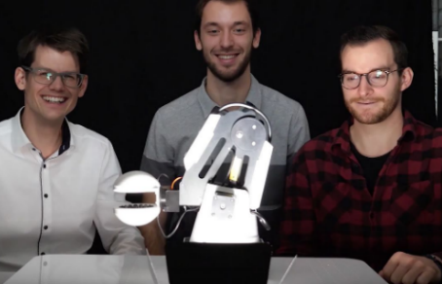
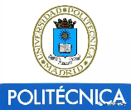
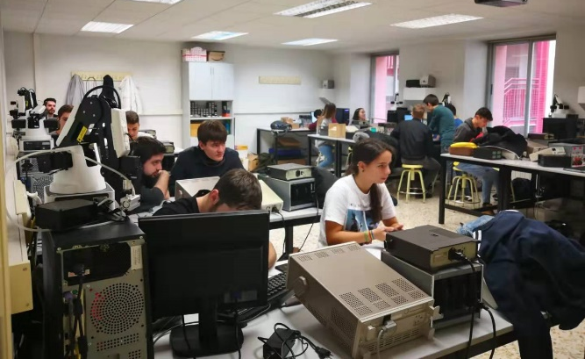
Swiss Federal Institute of Technology Zurich
Switzerland
Researchers from ETH Zurich use DOBOT Magician to develop a no-touch robotics solution. The solution aims to address the challenge of gripping delicate and small components in the watchmaking industry and semiconductor industry. The acoustic gripper eliminates the need for an extensive set of expensive high-​precision grippers.
Polytechnic University of Madrid
Spain
Higher Technical School of Engineering & Industrial Design incorporates 10 sets of Dobot Magician to its electronica digital instrumentation electronic courses. The course combines DOBOT robots with ARDUINO and MATLAB to teach junior students electronics and robotics. The course offers a total of 75 lessons in the school.
43

Slide 10

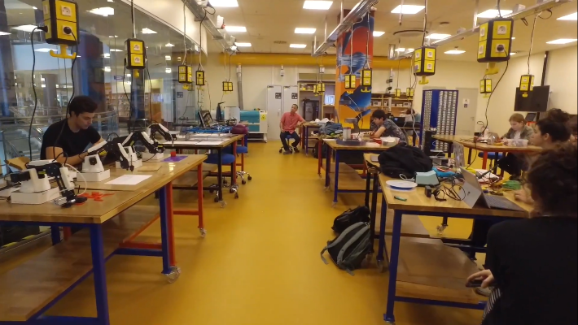
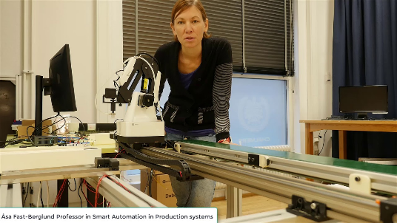
Sabancı University
Turkey
Multiple sets of DOBOT Magicians are included in the “Collaboration Space” in the Sabancı University Information Center. At the Collaboration Space, students get hands-on with programming, robotics, virtual reality, Arduino/Raspberry Pie, photography, 3D modeling, and 3D printers. The place is home to events and seminars on maker culture and now keeps open to Sabancı University students and community, and academics experts in different fields.
Chalmers University of Technology
Sweden
Students at the Chalmers University of Technology in Gothenburg, Sweden, use 2 sets of DOBOT Magician to build two low-cost automation demos, meaning to investigate the possibility of creating simple assembly stations for Volvo Trucks AB under 5000 euros.
44

Slide 11

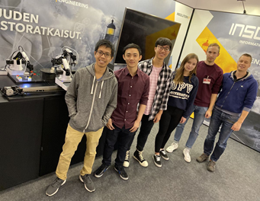
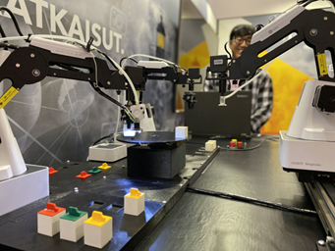

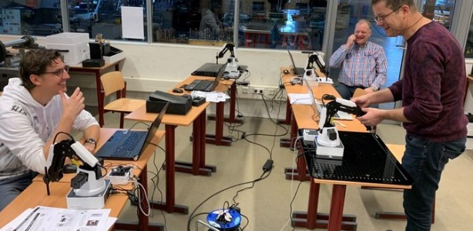
Häme University of Applied Sciences
Finland
Häme University has been using DOBOT Magicians and other kits for programming learning and secondary development research since 2019. Through modeling, writing control and planning software, students program the robot to perform specified tasks, and improve their understanding of robotics and its control system, operating software and independent programming and development capabilities.
Summa College
Netherlands
Professor Jorg Duitsman brings 20 sets of DOBOT Magician and 2 sets of DOBOT M1 to his robotics course. Mr. Jorg has 4 classes of 25 in total. Through the course, his students learn how to control Dobot Magician through teaching and play method and programming on Blockly, how to combine different systems PLC/Arduino/Raspberry Pi with the Dobot robots, how to apply robots in real world and how to use different sensors on the robot and figure out which one is necessary.
45

Slide 12

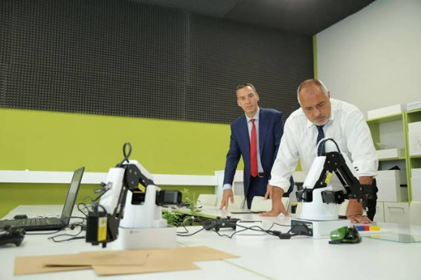
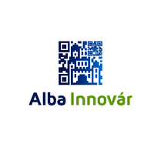
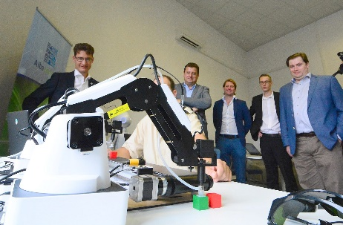
Vocational High School of Computer Programming & Innovations
Bulgaria
Sets of DOBOT Magician are selected for the programming courses at the First High School of Computer Programming and Innovation in Bulgaria. The school gives students aged 15+ 5 years of training. With the help of DOBOT Magician, students learn programming languages ​​C, C ++, JavaScript, C Sharp, etc. The goal is to equip students with specific skills in hardware design, cloud technologies, robotics, artificial intelligence and cybersecurity.
Prime Minister of Bulgaria Boyko Borisov is checking with DOBOT Magician
Alba Innovár Digital Experience Center
Hungary
Alba Innovar uses sets of Dobot Magician and peripheral kits to conduct robotics design, programming and automation courses for 5,000 students. The school has also an adult training program to train highly qualified professionals. The instructors speak highly of Dobot Magician robots, praising the robot's ability to show the actual industrial environment and simulate how a real-world industrial robot works without the cost of it.
46

Slide 13
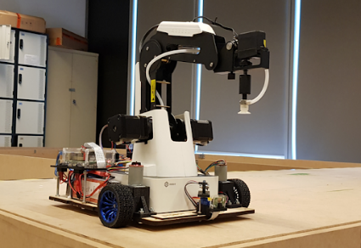
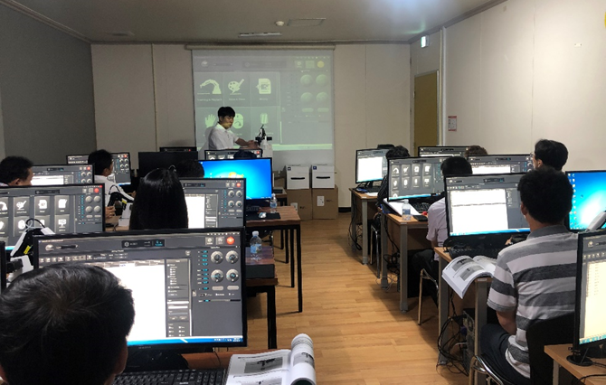
University of Technology Sydney
Australia
20 sets of DOBOT Magicians are used for teaching and assignment at the School of Mechanical and Mechatronic Engineering, University of Technology Sydney. This subject is an introduction to industrial robotics and the underlying algorithms and mathematics. Students are required to develop an understanding of the representation of an industrial robot’s manipulator pose, kinematics and control. They can learn about a variety of robot manipulation tasks that are, or could potentially be performed by robots.
Mobile Robot, a Mechatronics Project by Students at UTS
Busan Institute of Science and Technology
South Korea
10 sets of DOBOT Magicians are used for the teaching of programming, electronic and robotics courses at Busan Institute of Science and Technology. The course targets students aged 20-24 who have 3-hour lessons per week for 16 weeks total for one semester. For a class of 20 students, 2 students share one robot. According to the teacher, with a desktop robot like DOBOT Magician, students improve their understanding of AI education and robotics through the various interfaces and coding languages.
47

Slide 14
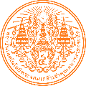
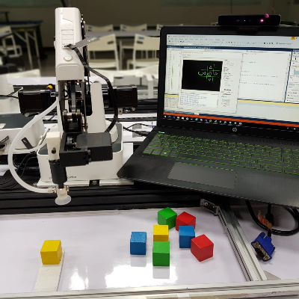
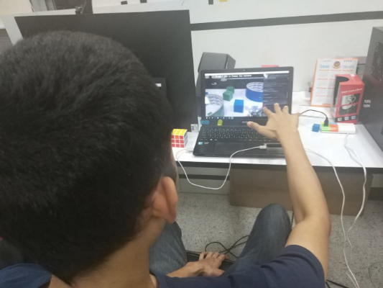
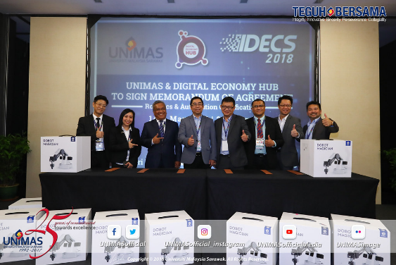
King Mongkut's Institute of Technology Ladkrabang
Thailand
King Mongkut‘s Institute of Technology Ladkrabang incorporates 20 sets of DOBOT Magician and 14 sets of Dobot M1 for teaching and research in robotics, PLC, automation, LabView, among other artificial intelligence and robotics subjects in its Advanced Manufacturing Innovation Institute. The goal is to provide an all-in-one learning platform to train professional robotics talents.
The student is trying to control a Dobot via Leap Motion.
University of Malaysia, Sarawak
Malaysia
University Malaysia Sarawak (UNIMAS) joins hands with Digital Economy Hub (Sarawak) Sdn Bhd (DEH) to conduct the robotics and automation certification program using DOBOT Magician. With this partnership, the students from UNIMAS have opportunities to build simulations of real-world manufacturing scenarios on DOBOT Magician and gain first-hand experience with industrial automation and AI technologies.

Slide 15

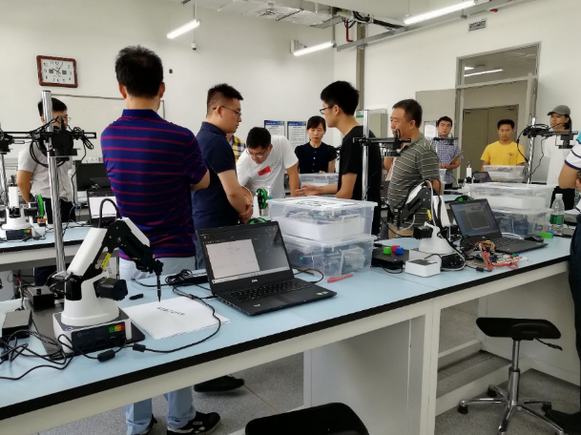
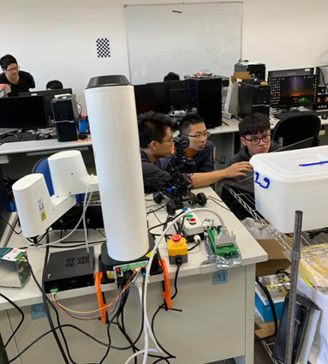
Harbin Institute of Technology
China
DOBOT and Harbin Institute of Technology (HIT), also known as China’s MIT, work together to build the Intelligent Perceptive and Control Laboratory for students at the School of Mechanical Engineer and Automation, Harbin Institute of Technology. With dozens of DOBOT Magician robots at the lab, not only students can learn robotics and advanced programming, but also they get to draw inspirations from real life and design their own projects.
National United University
Taiwan, China
The National United University uses DOBOT M1 for research and learning on robot vision and industrial applications.
The instructors use software programming and hardware expansion to develop robotic application scenarios. This approach helps students deepen their understanding of the subject, enhance their professional capabilities, and conduct innovative scientific research.
49

Slide 16
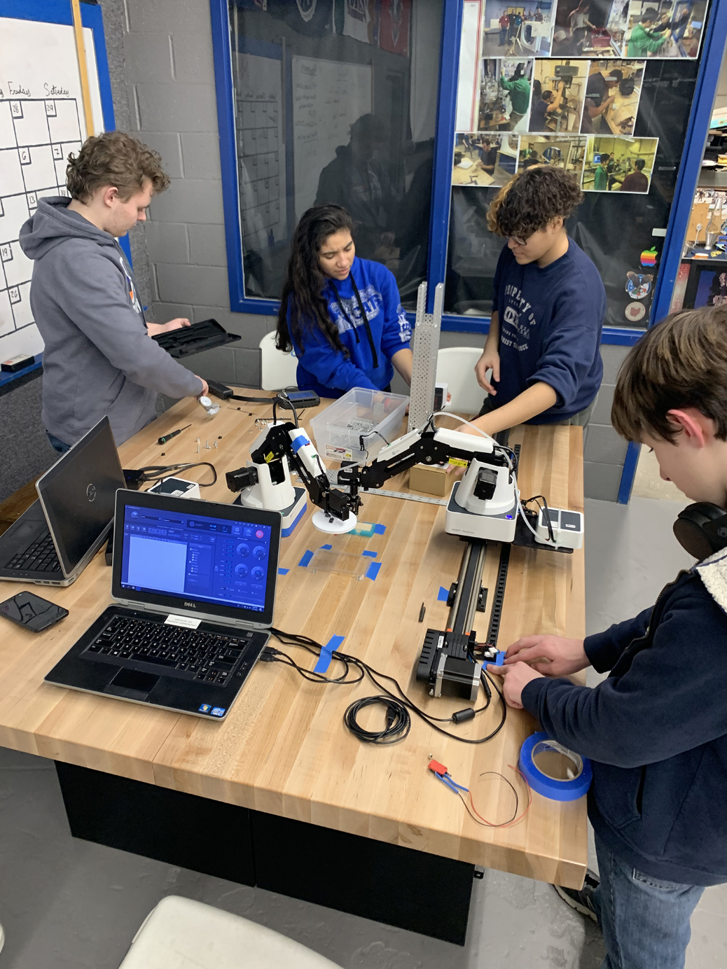
K12 Schools

Slide 17

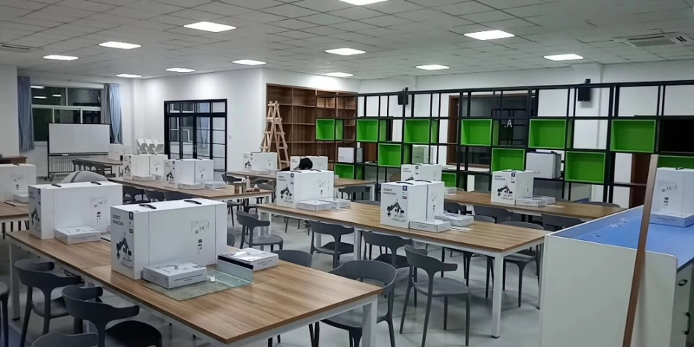
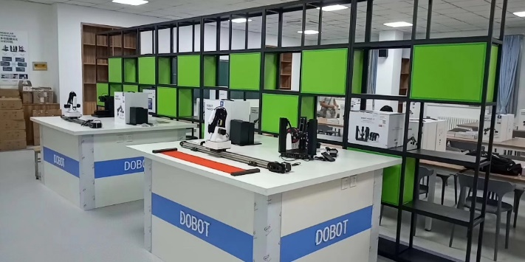

The High School Affliated to Shangdong University
China
The High School Affiliated to Shangdong University partners with DOBOT to build an Artificial Intelligence Lab. The lab includes DOBOT robotic arms, accessory packages, AI-Stater vehicle, competition sets and training sets, all designed for AI teaching and experiment.
Combined with the “data & computer” and “information system “ in the information technology curriculum, the lab offers students optional courses and extracurricular courses that are infused by robotics hardware and software control, machine vision, and graphical programming. The lab means to help students develop students’ hands-on ability, creativity and problem-solving skills.
51

Slide 18



Dayton Elementary School
United States
Dayton Elementary School in Indiana State includes sets of DOBOT Magicians in its Design and Innovation Studio. As part of the partnership with IN-MaC, STEM Education Works, and Purdue University’s Polytechnic Institute, the studio seeks to give students hands-on experience with AI technologies.
Through the use of robotics, coding, and engineering, students in the lab learn skills as well as design thinking, problem-solving, and creativity, all of which are employability skills that can be applied in the future workforce.
With a shortage of workers qualified to become manufacturing leaders, the lab also helps students explore new career pathways at an early age. The partners have also developed similar AI & STEM learning labs in large manufacturing plants around Indiana, including Subaru of Indiana Automotive and Honda Manufacturing of Indiana, where students are able to collaborate directly with current innovators in manufacturing and sharpen their skills.

Slide 19






Copley High School
United States
Kirby Harder, head of Engineering & Technology Dept. at Copley High School, Ohio uses several sets of DOBOT Magician, conveyor belts and slide rails for his engineering class. This course includes 3 different engineering classes for students. Students take the class for 1 hour per day, 5 days a week. Mr. Harder plans to take his engineering class students to compete in the 2020 National Robotics Challenge in the country using the Dobot Magician. They have decided to do the Manufacturing Work Cell portion of the Robotics Challenge.
Quakertown Community High School
United States
Multiple sets of DOBOT Magician are used for the Computer Integrated Manufacturing (CIM) class at Quakertown Community High School, Pennsylvania. Mr. Polk, the CIM teacher, guides his students to use DOBOT Magician robots and VEX robotics to build mini automated assembly lines in simulation of real word scenarios.
The course runs a full school year and seeks to equip students with many of the skills today’s employers are seeking such as problem solving, teamwork, and critical thinking.

Slide 20




Cazenovia High School
United States
12 sets of DOBOT Magician, 2 sets of conveyor belts and 2 sets of vision kits, 2 sets of slide rails are incorporated into the Computer Integrated Manufacturing (CIM) class at Cazenovia High School, New York since the 2017-2018 school year. According to Chris Hurd, the CIM Instructor, with the desktop robot in the classroom, his students have learned the concepts and application of advanced robotics better and faster than ever before.
Barren County High School
United States
Barren County High School in Kentucky has been using DOBOT Magician in its Barren County Innovation Zone since 2018. The place is created to compliment hybrid programming offered at their high school and their Area Technology Center. The Innovation Zone provides career exploration and training for students in Engineering & Design and Information Technology/Computer Science classes. These programs accommodate student interests and focus on the priority sectors for future jobs in the State.
54

Slide 21



Årstad High School
Norway
Årstad
16 sets of DOBOT Magician are used the programming, electronics and robotics courses at Årstad High School in Norway. The course targets students aged 16-20 who have 4 classes per week for a whole school year. One class may include 20-25 students and 2 students share one robot.
Tallinn Secondary School of Science
Estonia
Tallinn Secondary School of Science has been using DOBOT Magician in its Innovation Lab since 2019. The laboratory aims to develop students’ engineering competencies through inquiry-based learning and practical assignments and to offer other educational institutions in Tallinn opportunities to experiment with these innovative educational tools and methods in engineering. The lab targets students aged 7–12 in Tallinn Secondary School of Science and other schools in Tallinn.
55

Slide 22




Institut 4.0 Training School
Slovenia
The Institut 4.0 Training School uses DOBOT Magician to develop basic courses for robotics and industry 4.0. The course targets students aged 10-12. The instructor uses the robots and conveyor belts to build industry 4.0 assembly line to show student show modern manufacturing works.
IES Eduardo Merello High School
Spain
Multiple sets of DOBOT Magicians have been used as part of the GM Electromechanical Maintenance Project course at IES Eduardo Merello High School since the 2019-2020 academic year. DOBOT Magician is brought in to help students learn better beyond theory and concepts of mechanical engineering.
56

Slide 23




Qatar Science & Technology Secondary School for Boys
Qatar
A number of DOBOT Magicians are incorporated into the Robotics Lab at Qatar Science and Technology Secondary School for Boys, a governmental, specialized scientific school that adopts an integrated educational approach based on the teaching of AI. The lab provides students a place to develop their critical thinking and problem-solving skills.
GEMS Dubai American Academy
Dubai
GEMS Dubai American Academy incorporates DOBOT Magician into its new Center of Excellence for Artificial Intelligence and Robotics. The Center of Excellence aims to promote educational and research in AI and Robotics. It bridges the gap between businesses and educators with a distinctive capability to harness the intellectual energy of the academic world with AI and robotics technologies.
57

Slide 24



Saint Edward's Catholic Primary School
Hong Kong
Saint Edward‘s Catholic Primary School combines DOBOT Magician with a new curriculum and integrates it with other subjects. Students not only can learn how robotic arms work but also have a broader understanding of what is AI and what AI means to the future. Mr. Feng Lirong, the principal, says that the introduction of professional equipment such as robotic arms as early as elementary school may seem a bit too much, but their goal is not only to focus on the robotic arms but on the integration with other equipment to enable students to learn how AI works in the real world settings. "
United World College of South East Asia
Singapore
IDEAS Hub at United World College of South East Asia incorporates DOBOT Magician to its STEAM Education project. Students learn how to program Dobot Magician using Blockly and program the robot to perform specified tasks like packaging, palletizing and pick & place. Through these tasks and hands-on experience, students can better make sense of industrial automation and the role of robotics in the industry.

Slide 25

Businesses & Startups

Slide 26




Volkswagen
Germany
Volkswagen incorporates multiple sets of DOBOT Magician in its Digitization Campus located in the middle of the Hanover Exhibition Center (pavilion 36). They use DOBOT Magician to build a simulation of an automated vehicle production on a 1:18 scale. The campus provides training for trainees, apprentices and young students who are interested in job opportunities in the automotive manufacturing industry.
Students have hands-on experience with PLC programming, commissioning and programming of drives (FU, servo, stepper motors), 3D design, plant visualization, programming of small robots and industrial HRC robots, 3D printing, sensor technology/sensor networks, central system monitoring, programming of small computers (Raspberry Pi and Arduino) and electronics (analog circuits + digital assemblies in connection with small computers).
60

Slide 27



Honda Manufacturing of Indiana
United States
Honda Manufacturing of Indiana (HMIN) partners with Indiana Next Generation Manufacturing Competitiveness Center (IN-MaC) and Purdue University to launch the HMIN Drives Dreams Pathway (HDDP) IN-MaC Design and Innovation Studio. The studio provides opportunities for local middle and high schoolers to discover new ways to explore design thinking, problem solving, technology, and creative skills. Students can have first-hand experience with robotics, advanced manufacturing, coding, engineering, etc.
The studio is open to students from Indiana schools, homeschools, and community-based education organizations that are interested in AI & STEM subjects and exposure to careers in manufacturing, and improving career opportunities for Indiana youth.
Subaru of Indiana Automotive
United States
Subaru of Indiana Automotive partners with Indiana Next Generation Manufacturing Competitiveness Center (IN-MaC) and Purdue University to launch the In-MaC STEM Learning & Discovery Laboratory. The studio is part of the response to their Indiana’s new Initiative "The Rebound Indiana".
The lab provides students with hands-on learning experience technologies like DOBOT robots and 3D printers, aiming to spark an interest in the in-demand manufacturing industry. It is reported that the lab has served more than 2,000 students from 19 Indiana counties and one in Illinois since its opening on October 12, 2018.

Slide 28



MotorCortex AI
United States
MotorCortex AI, an artificial intelligence startup led by a Stanford engineering professor and a Carnegie Mellon roboticist, combines computer vision, machine learning, and DOBOT Magician to create a fruit packer for packaging lines.
MotorCortex AI addresses the labor challenge by bringing down the labor cost by over 5x. At the same time, they double the throughput, giving 10x boost to this fruit picking facility.
Yummy Future
United States
Two young graduates from the University of Illinois Urbana-Champaign created Yummy Future, an automated café at their alma mater. Empowered by DOBOT Magician, the Cafe is a wheeled white cube with espresso machinery and a robotic arm encased in glass. The Cafe is able to serve 100-200 cups per day and is frequented by the school students and teachers.
62

Slide 29
Other Cases
目录

Slide 30




Barboza Space Center
United
States
Barboza Space Center, a science and engineering prototyping company, has been featuring DOBOT Magician in their Mars Learning Adventures program since 2018. The program is designed to train junior astronauts, scientists and engineers and get them excited about working together and studying AI and STEAMD ++ project-based learning as they pursue careers in the aviation and aerospace industry.
Under this program, students work as interns and "Tiger Team" members to study STEAMD ++ topics. They build simulated Martian, Earth habitats, robots and satellites, create science experiments and develop learning materials of space mathematics for the 2020 Mars Learning Adventures Space Science and aviation programs.
64

Slide 31






Mobile STEAM Classroom
United
States
The LaPorte County Public Library in Indiana State has launched the Mobile STEAM Classroom for local students who do not have access to STEM equipment especially during quarantine lockdown.
The library is looking to provide hands-on education for students, and making it mobile means they can now bring the school to the students. According to the report, the library is partnering with local schools and businesses to help give kids the exposure to these fields early on.
移动STEAM教育课室 |
美国
Frankfurt Public Library
Germany
DOBOT Magician among a whole variety of robots were moved into the Public Library of Frankfurt to kick off the “Robot-Invasion” in early August 2019. Subsequently, the robot has been put on a one-year display to engage visitors especially the younger generation in getting their hands on the robot and try different functions of the robot.
According to Ms. Elfriede Ludwig, head of Digital-Services-Team at the library, DOBOT Magician teaches young adults how robots plays its role in the industry.
65

